Slide 1
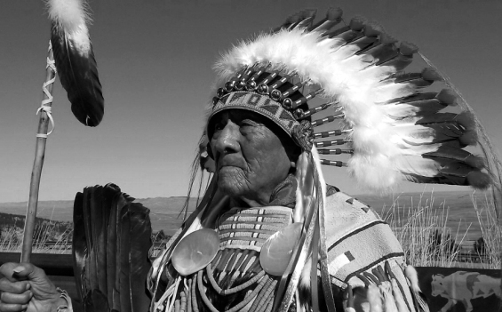



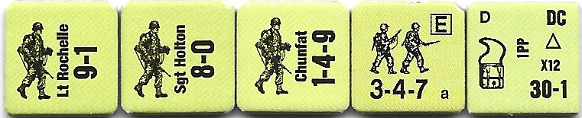



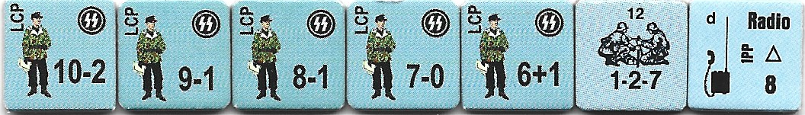
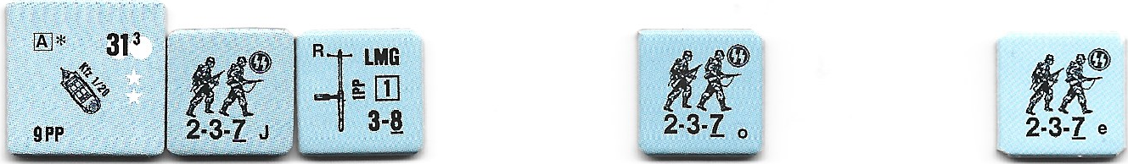
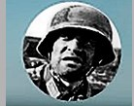
“High Bird, the Last Crow War Chief”
Schillersdorf, Germany — March 25th, 1945
What follows is a hypothetical creation of the actual deeds of Joseph Medicine Crow. Joseph, would be the last War Chief of the Crow Nation. He successfully performed the four tasks required in order to become a War Chief. Joseph would earn this honors as a scout for the 411th Infantry Regiment, 103rd Infantry Division. The final task required the taking of horses from an enemy. The available history indicates that Joseph’s unit had tracked a battalion HQ group of officers ostensibly from the 6th SS Mountain Division NORD. Schillersdorf is the only shared area of conflict that I was able to confirm for the 103rd and 6th SS. Having spotted the Germans bedding down for the evening. Joseph requested that he be allowed to go in before a pre-assault artillery barrage to stampede the horses away.
VICTORY CONDITIONS: The American Player wins immediately upon controlling the German Radio or the side with the most Victory Points at game end is declared the winner. Each Horse counter exited by Joe Medicine Crow is worth 2 EVP. Each building controlled is worth 2 VP. CVP is accrued normally. German SMC’s may retain and gain control of building hexes during the scenario.
17z
American Player Moves First | 1 | 2 | 3 | 4 | 5
German Player Sets up First
Board:
17a (only rows A-P are playable.)
Scout Elements of Co.K, 411th Infantry Regiment, 103rd Infantry Division (ELR 5) (SAN 2) (Set up: enter Turn 1 on the west edge)
5
Battalion HQ 6th SS Mountain Division “NORD” (ELR 5) (SAN 2) (Set up: in Buildings I8, L6, M5, N6 and/or P9 per SSR 3)
2
Battalion HQ Patrols 6th SS Mountain Division “NORD” (ELR 5)
Enter Turn 3 on the P5 Road Hex and exit through Hex A6 if no enemy units are seen.
Enter Turn 2 via K1 Hex and exit via K10 Hex if no enemy units seen.
Enter Turn 1 via I10 Road Hex and exit via I1 Hex if no enemy units seen.
Special Rules/Notes:
EC are Moderate with no Wind at start. Kindling (B25.11) is N.A.
Night Rules (E.1) are in effect. The NVR is 3 hexes. Americans are the scenario attacker and may use Cloaking: the Germans are the Scenario Defender. The Majority Squad Type for both sides is Normal. Americans are Stealthy (A11.17) Straying (E1.53) is N.A.
German SMC’s must set up in selected building hexes with a maximum of two SMC’s per building. The 1-2-7 has the Radio and must setup with the 10-2.
Place Horse (10) Counters in the following Hexes: K4, K5, L3, L4, L5.
The L4 Building is a Stables and is treated as a Factory (B24.73).
Hero represents Scout Joseph Medicine Crow. Joe acts independently upon seeing the horses and immediately moves to gather all 50 horses in order to steal them and return them to American lines. While Joe is able to manage and control all 50 (stack is considered Over stacked (A5) for purposes of resolving fire attacks against it. Joe gains control automatically, but must roll a Task Check DR each time he enters a hex containing a horse. Failing this TC results in immediate loss of concealment and Pins Joe for the duration of that turn. Joe may elect to exit at anytime with any number of Horse Counters. Each Horse Counter is worth 2 EVP.
Aftermath: Under the cover of early morning darkness, Joseph successfully snuck into the farmyard area and drove the horses away prior to the general assault of his unit against the SS officers.
Scenario GJ155

